Slide 1
Design Patterns

Slide 2
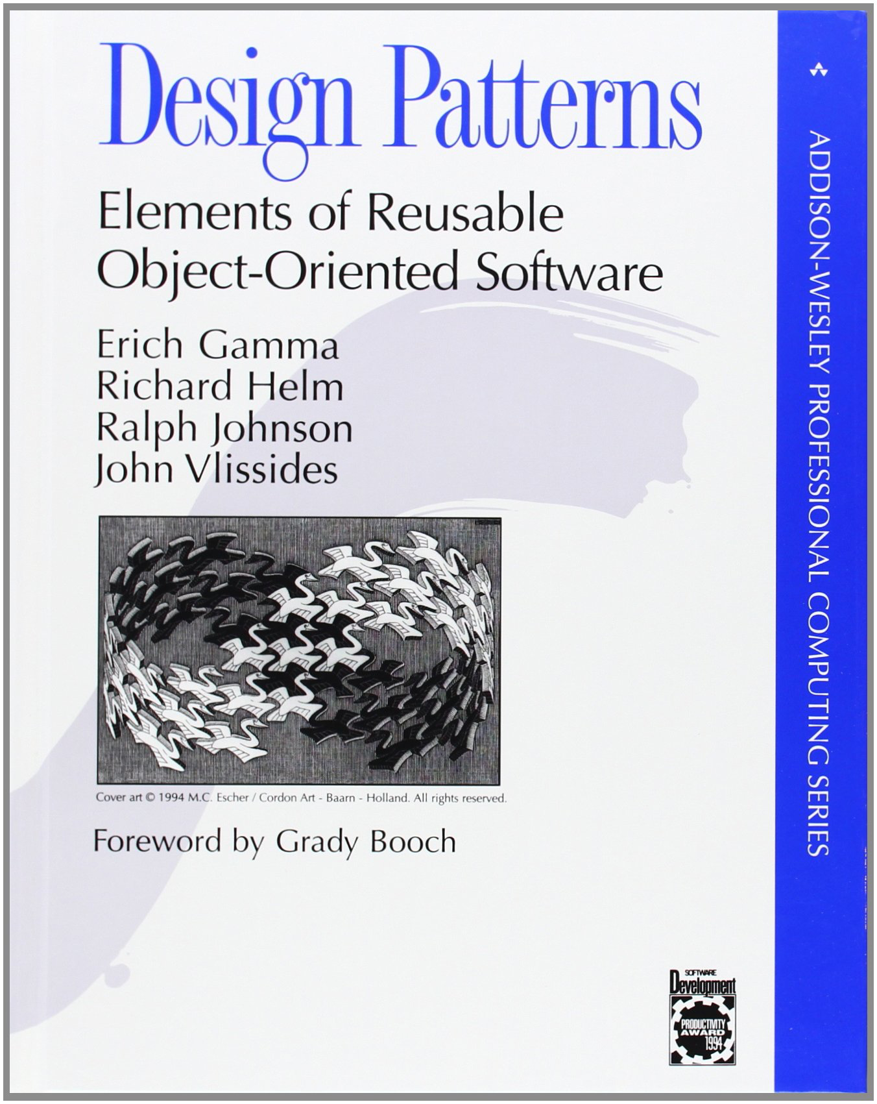
Gamma, Erich; Helm, Richard; Johnson, Ralph; Vlissides, John (1995). Design Patterns: Elements of Reusable Object-Oriented Software. Addison-Wesley. ISBN 0-201-63361-2.

Slide 3
In Our Class
Iterator
Factory method
Composite
Singleton
Observer
Strategy
Decorator

Slide 4
Iterator

Slide 5
Motivation
Computers vs. Calculators:
Computers can perform the same operation many times
Programming Languages:
Harness this power using loops
A Problem:
Traditional looping requires an understanding of the structure of the "aggregate"

Slide 6
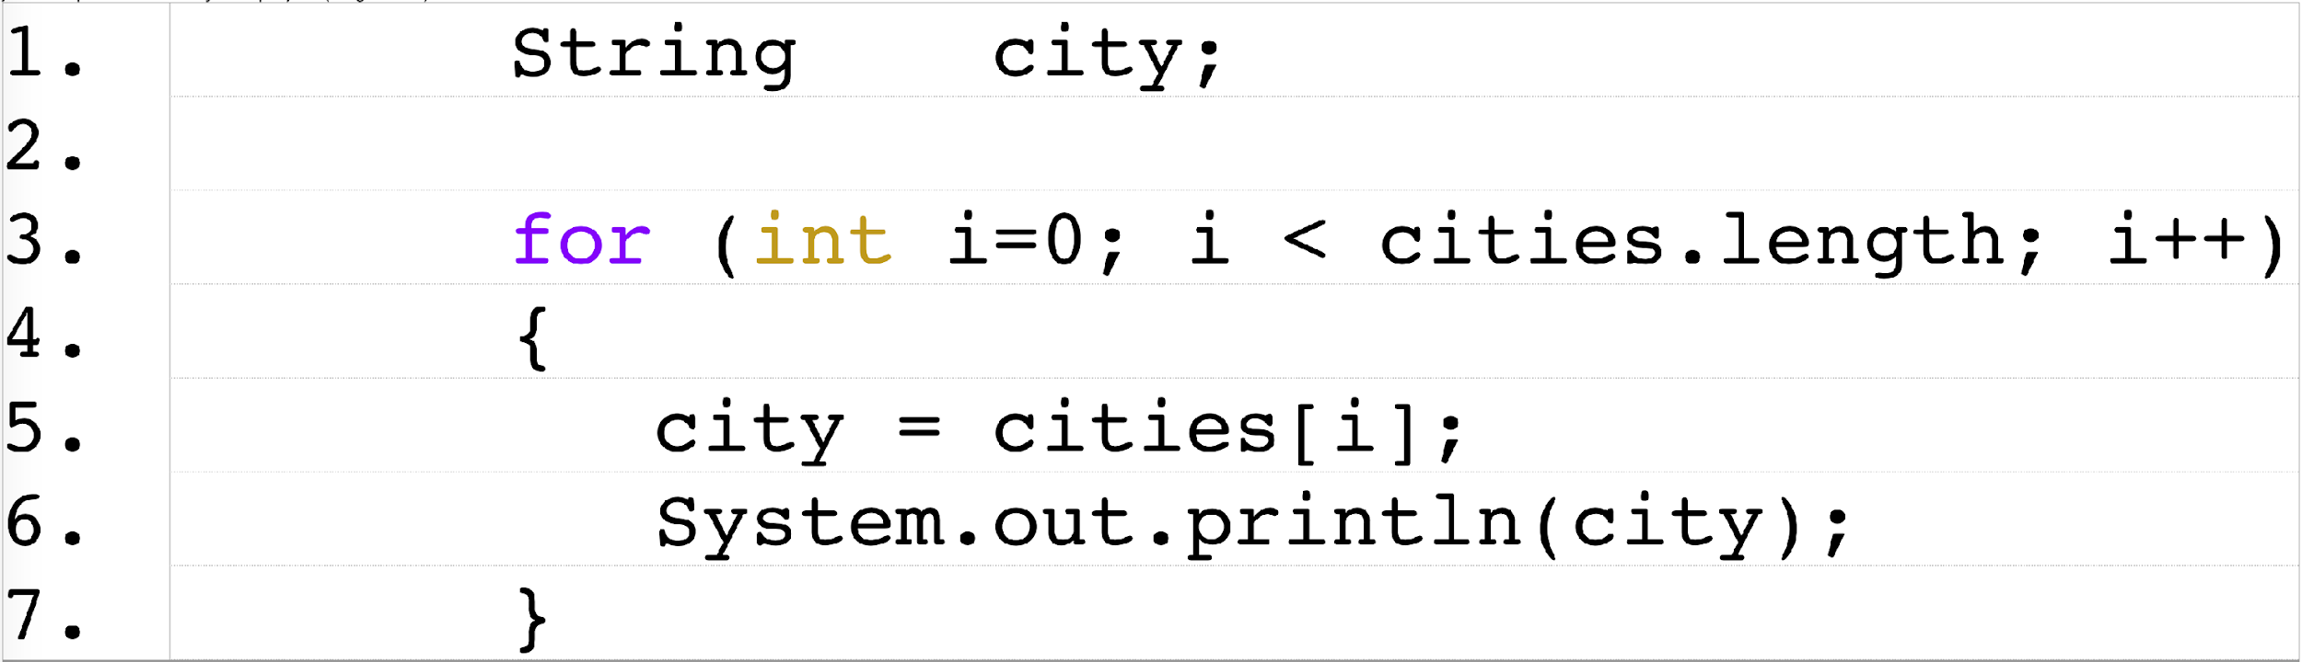
Looping and Aggregates
Looping Over an Array

Slide 7
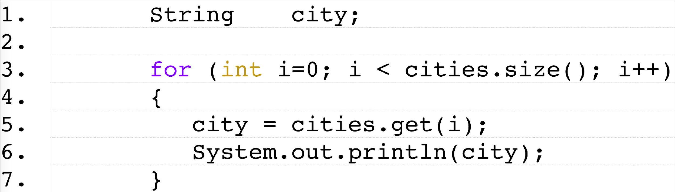
Looping and Aggregates (cont.)
Looping Over an ArrayList

Slide 8
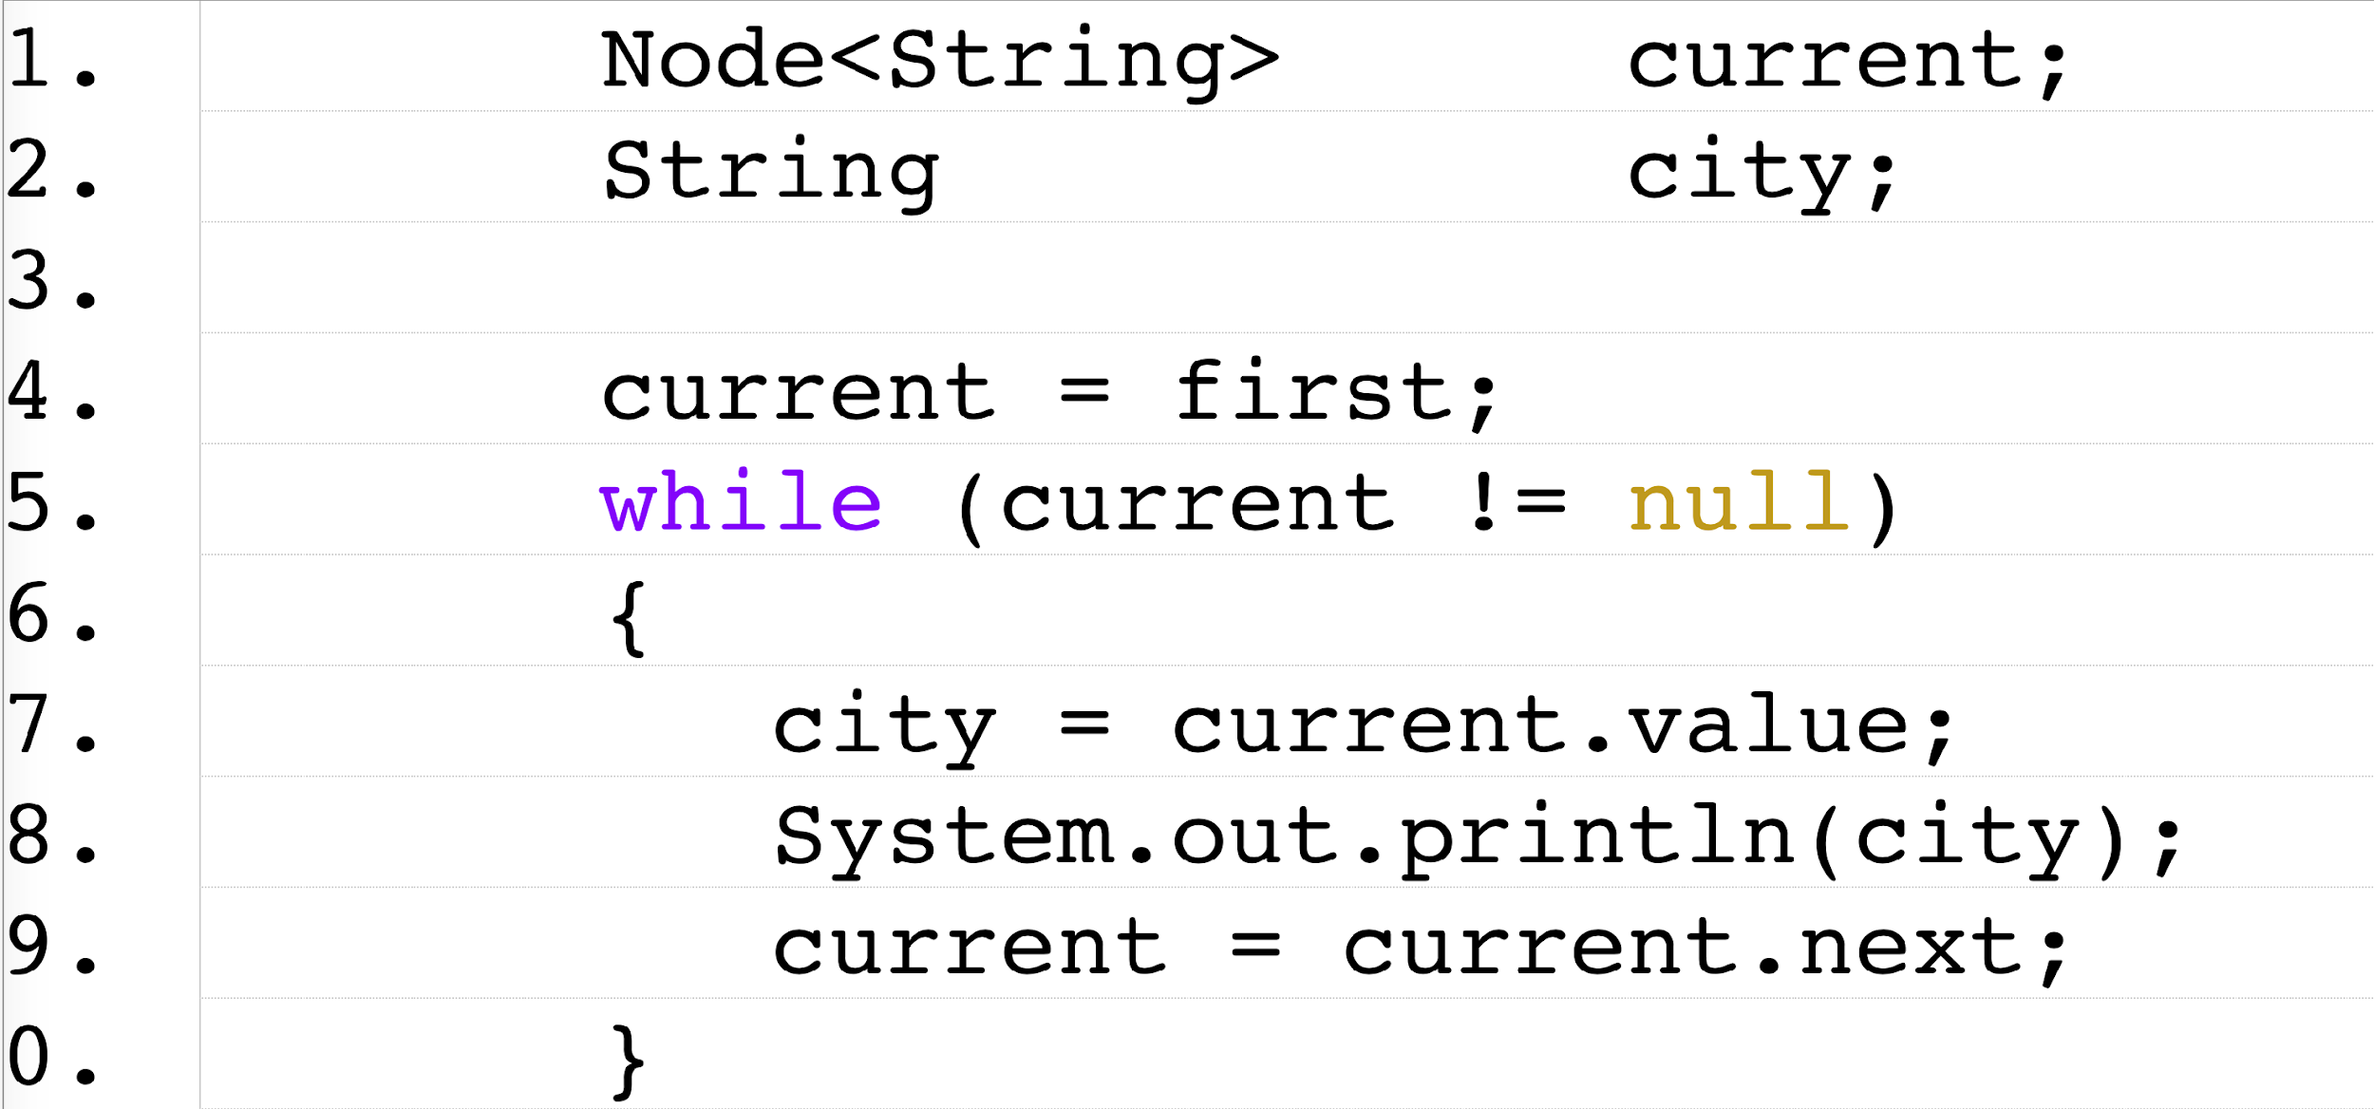
Looping and Aggregates (cont.)
Looping Over a Linked Structure

Slide 10
Some Observations
Applications often "loop" over the same aggregate object in many classes and methods
Changing from one aggregate to another is, as a result, very inconvenient
The Iterator design pattern enables us to access the elements of an aggregate object while hiding its internal structure

Slide 11
Important Operations - Commonalities
Reset its "pointer" (or cursor) to the first element.
Determine if there are any more elements in the sequence.
Move its "pointer" to the next element.
Retrieve the "current" element.

Slide 12
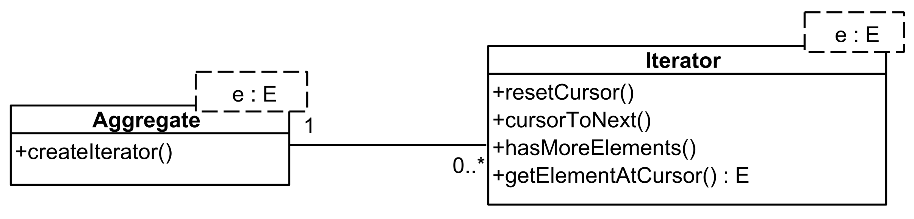
The Iterator Pattern

Slide 13
Examples in Java
The Aggregates:
Classes that realize the Iterable interface (including classes that implement the List interface like ArrayList and classes that realize the Set interface like HashSet.
The Iterator:
Classes that realize the Iterator interface

Slide 14
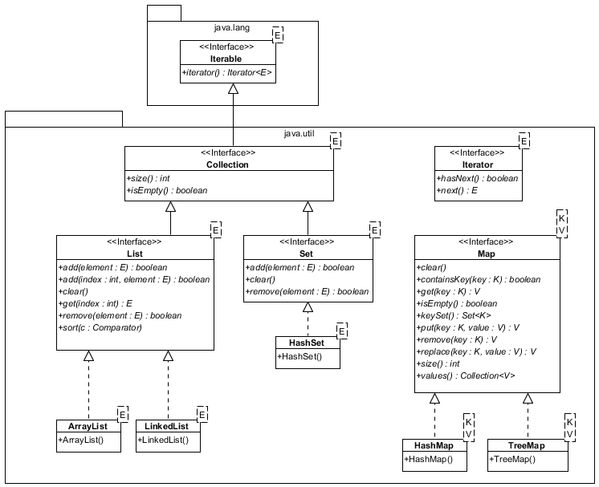
Examples in Java (cont.)
Note that the Map interface does not extend Iterable or Collection, but one can get a Set or Collection object from a Map.

Slide 15
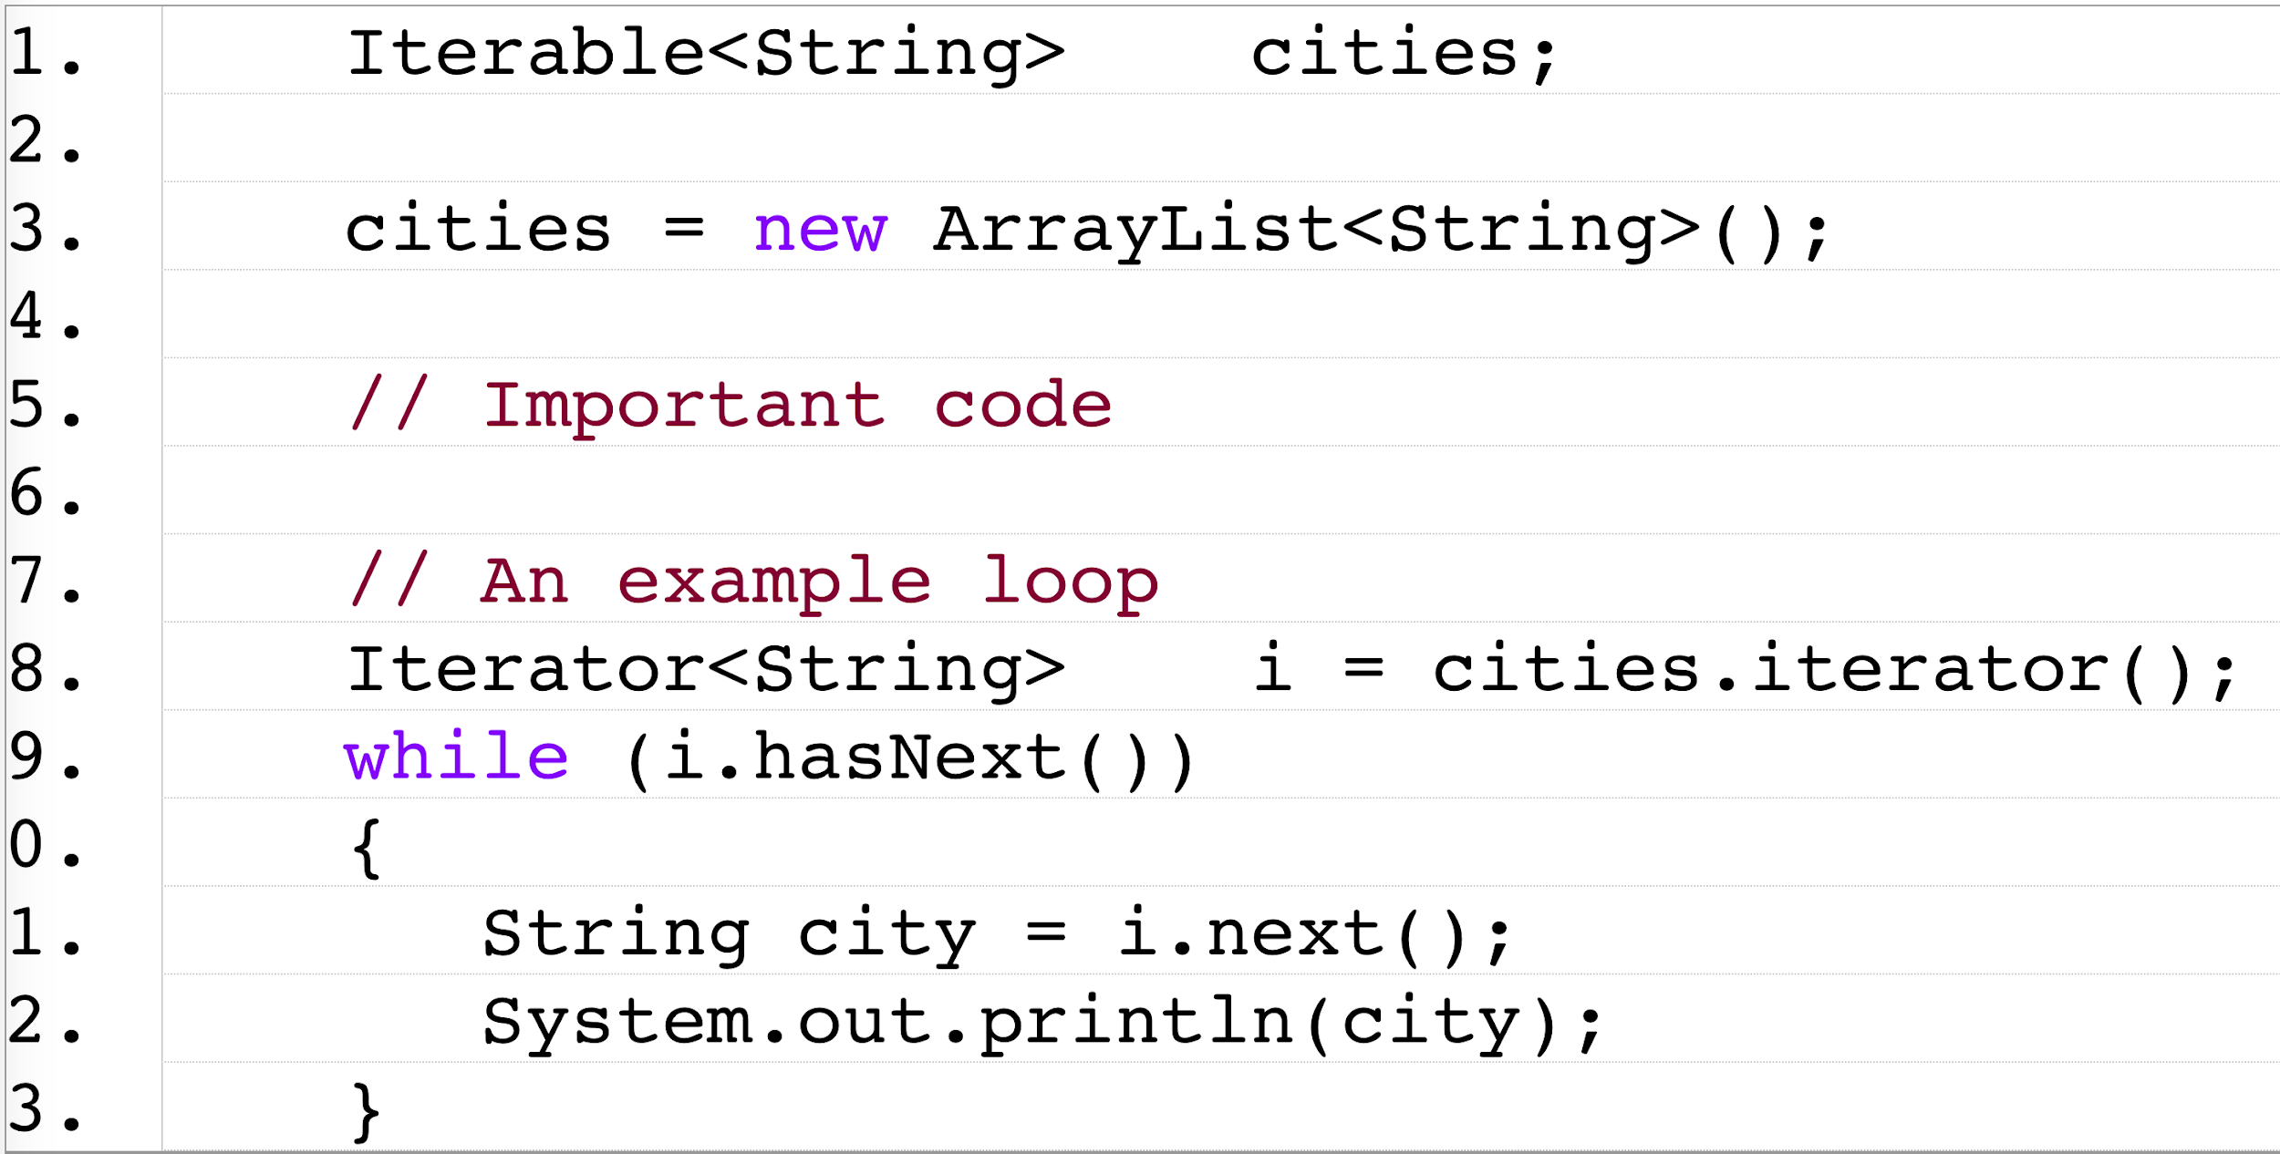
Benefits of the Iterator
What code must change to use a HashSet instead of an ArrayList?

Slide 16
Benefits of the Iterator (cont.)
The Principle Benefit:
You can easily change the type of aggregate being used without having to change any loops (and, if you declare variables properly, without having to change any of the declarations, only the instantiations)
Other Benefits:
Several objects can be "looping" over the elements in the aggregate at the same time
A "filtered" list (e.g., names starting with the letter "A") is handled in exactly the same way that the "unfiltered" version is

Slide 17
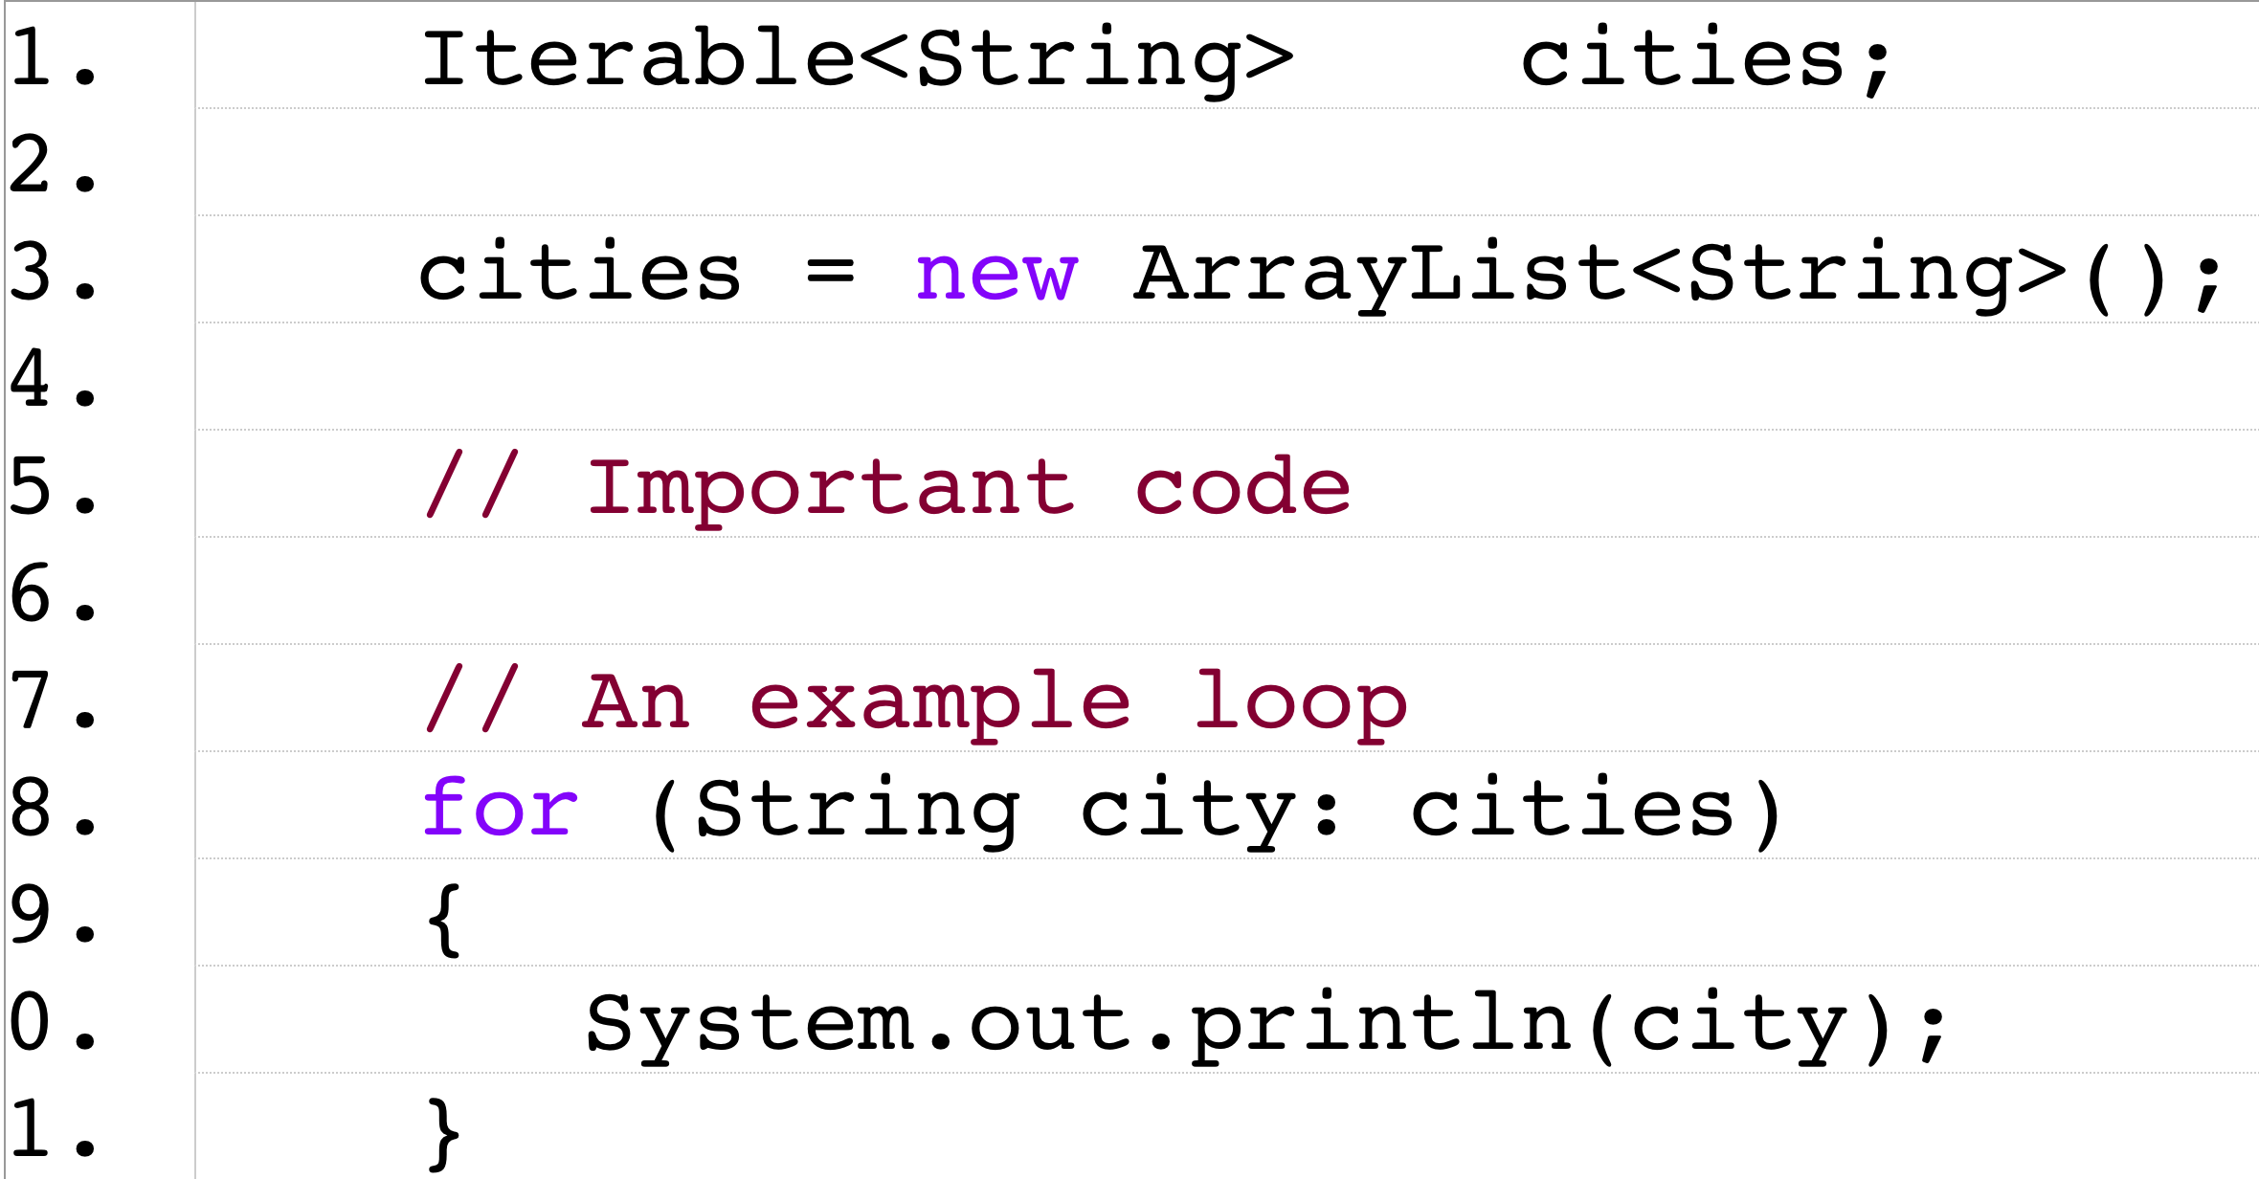
The "New" Loop
The Idea:
Include a control structure that takes advantage of the Iterator pattern (i.e., create a "for each" loop for any Object that implements the Iterable interface)
Syntax:
for (Class element : Iterable) statement
Example:

Slide 18
To Recap
Problems that Iterator can solve:
The elements of an aggregate object should be accessed and traversed without exposing its representation (data structures).
New traversal operations should be defined for an aggregate object without changing its interface.
Solution
Define a separate (iterator) object that encapsulates accessing and traversing an aggregate object.
Clients use an iterator to access and traverse an aggregate without knowing its representation (data structures).

Slide 19
Composite

Slide 20
Motivation
The Need:
Ignore differences between individual objects and compositions of objects
Examples:
Group "primitive" shapes in a drawing application

Slide 21
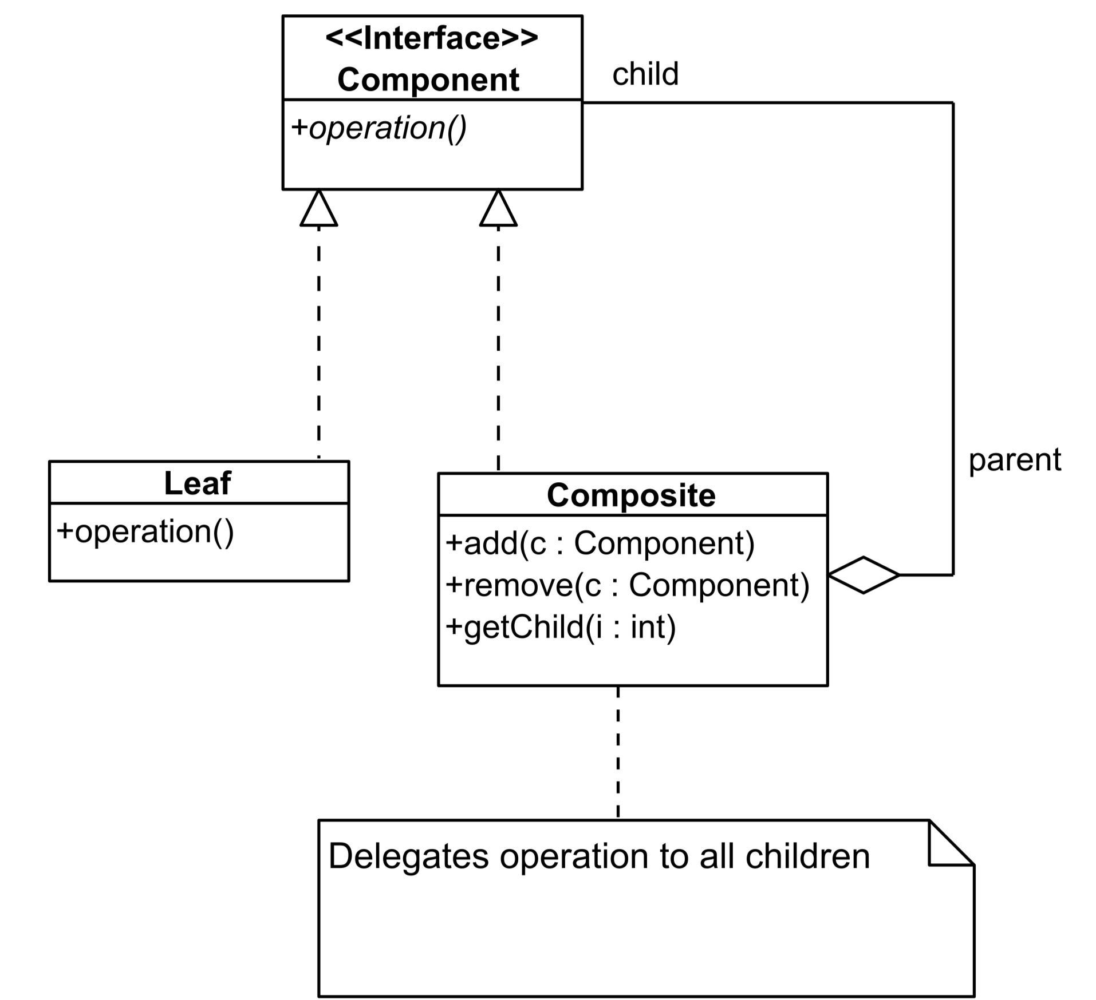
One Version
In UML:

Slide 22
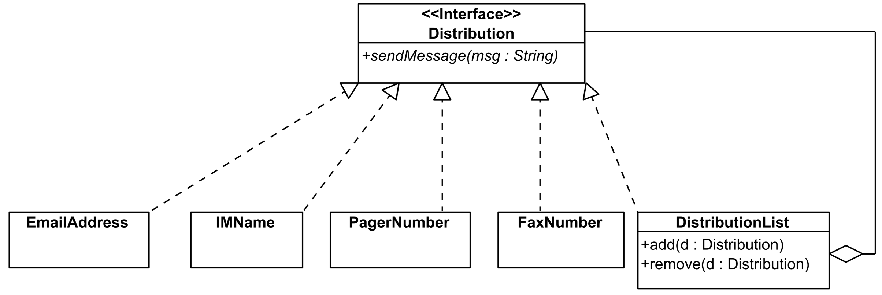
An Example
A Message Distribution System

Slide 23
To Recap
Problems that Composite pattern can solve:
A part-whole hierarchy should be represented so that clients can treat part and whole objects uniformly.
A part-whole hierarchy should be represented as tree structure.
Solution
Define a unified Component interface for both part (Leaf) objects and whole (Composite) objects.
Individual Leaf objects implement the Component interface directly, and Composite objects forward requests to their child components.

Slide 24
Singleton

Slide 25
Motivation
Some applications require exactly one instance of a class:
Windowing systems with one event queue
Word processors with one menu bar (for all documents)
Unfortunately, constructors can be called repeatedly:
In one method
In one class
Across multiple classes

Slide 26
Requirements of a Singleton
Create and return an instance of itself if one doesn't exist
Return the existing instance if one does exist

Slide 27
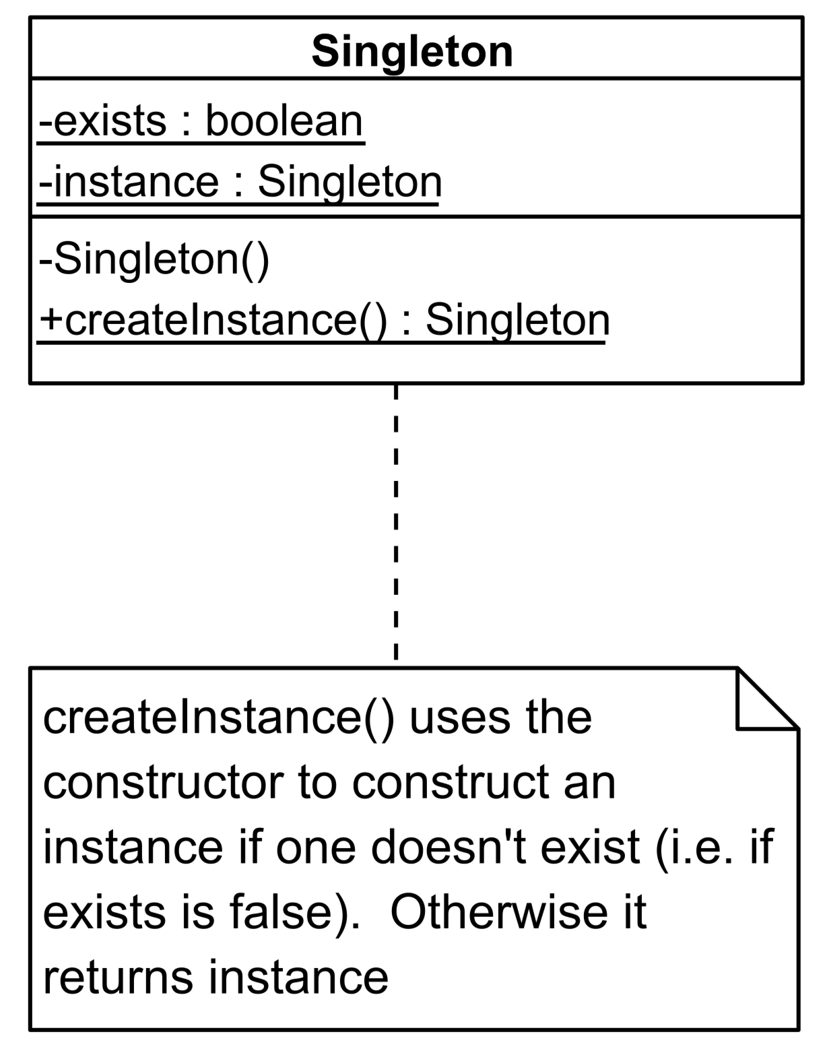
One Implementation of the Singleton Pattern

Slide 28
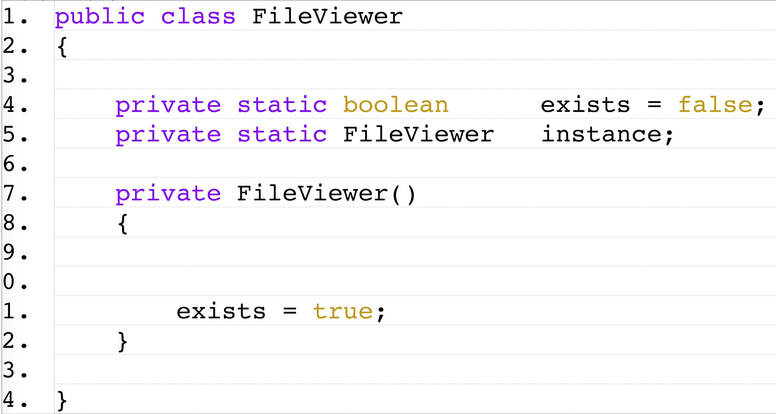
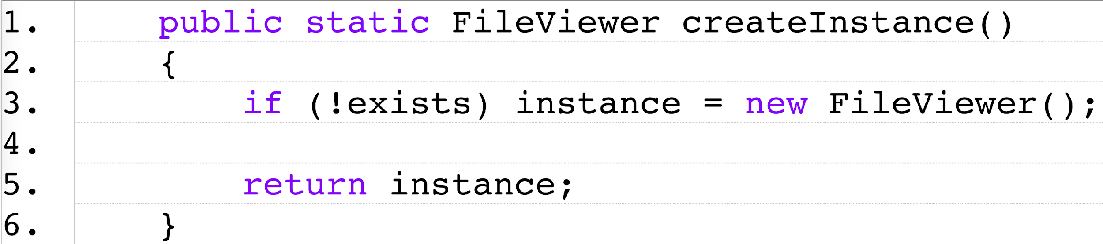
An Example
A FileViewer

Slide 29
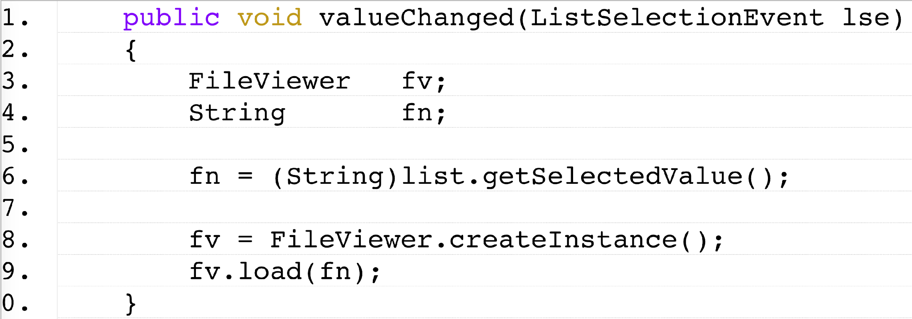
An Example (cont.)
Using a FileViewer

Slide 30
Thread Safety
A Potential Problem:
If the createInstance() method might be called by multiple threads, problems can arise
Resolutions:
Make createInstance() synchronized
Use eager initialization (i.e., instantiate instance when it is declared)
More: External Link

Slide 31
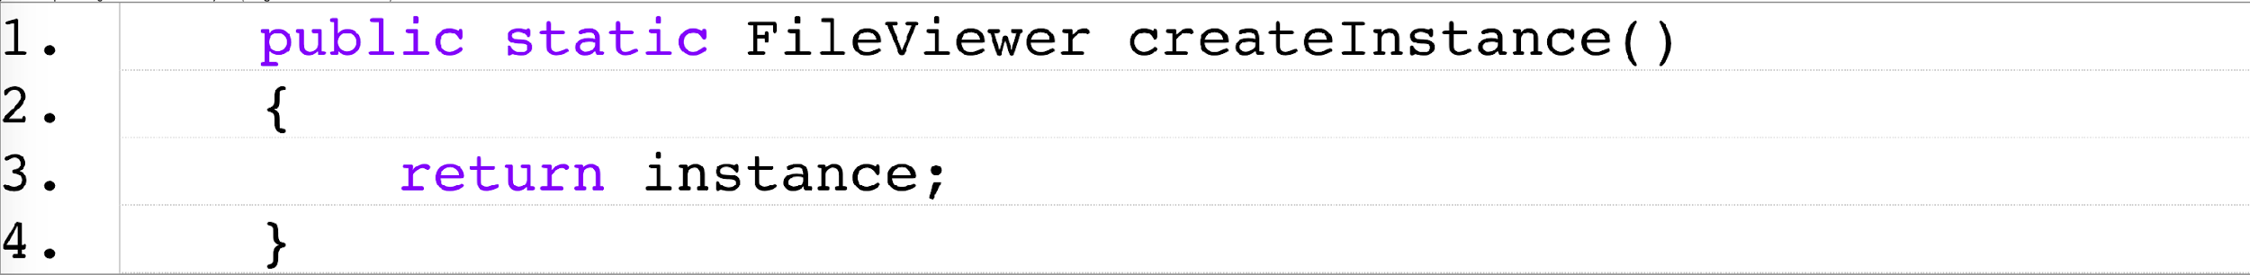
An Example (cont.)
Using Eager initialization

Slide 32
To Recap
Problems that Singleton pattern can solve:
How can it be ensured that a class has only one instance?
How can the sole instance of a class be accessed easily?
How can a class control its instantiation?
How can the number of instances of a class be restricted?
Solution
Hide the constructor of the class.
Define a public static operation (getInstance()) that returns the sole instance of the class.

Slide 33
Observer

Slide 34
Motivation
Objects often need to communicate with each other
Traditional message passing techniques tend to couple objects too tightly

Slide 35
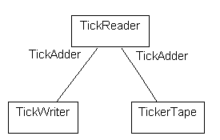
A Trading System Example
A Bad Design
Drawbacks:
Because TickReader calls the TickWriter and TickerTape it is not very re-usable
Every TickReader must have an associated TickWriter and TickerTape

Slide 36
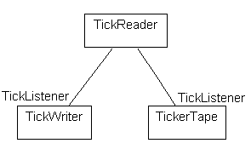
A Trading System Example (cont.)
A Better Design
Advantages:
A TickReader need only have a list of (zero or more) TickListener objects that it will inform

Slide 37
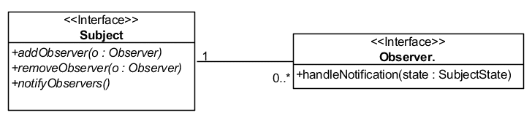
The Observer Pattern
Also known as Listener or Publish-Subscribe Pattern
Intent:
Define a one-to-many dependency between objects so that when one object changes state, all of its dependents are notified
Participants:
A subject
Some observers

Slide 38
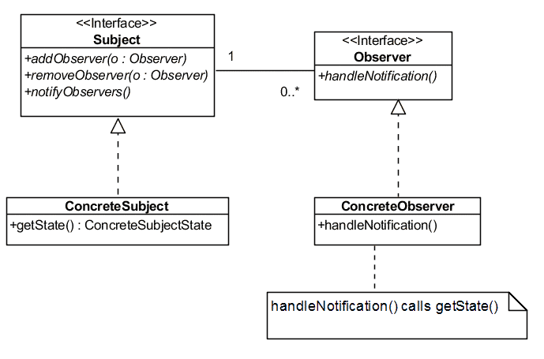
The Observer Pattern (cont.)

Slide 39
A Complete Example
A Silly Text Processor:
Counts the number of words that start with an uppercase letter
Save the lines to a file
Shows the progress (e.g., then number of lines processed)

Slide 40
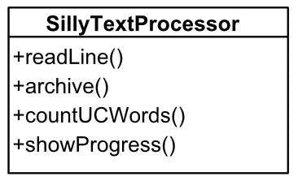
A Complete Example (cont.)
A Bad Design

Slide 41
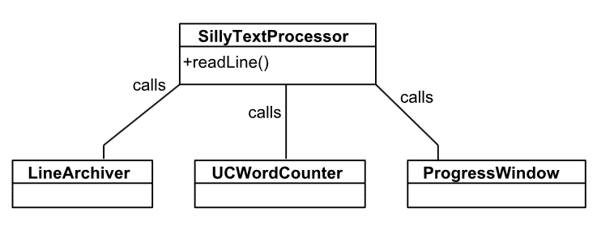
A Complete Example (cont.)
A Better Design
This design is better
It is, however, too tightly coupled

Slide 42
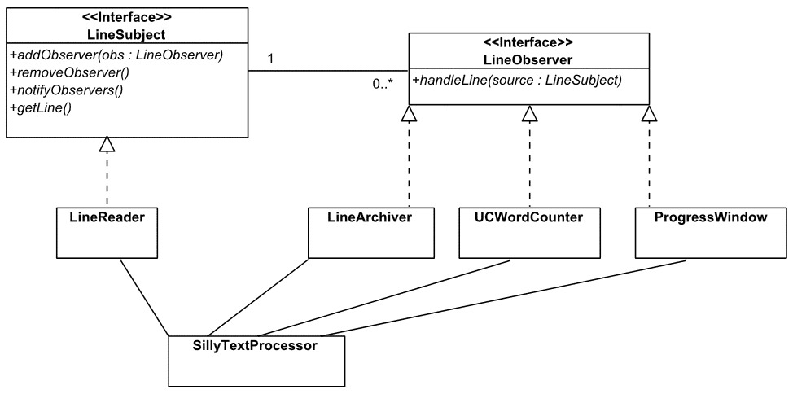
A Complete Example (cont.)
Using the Observer Pattern

Slide 43
Decorator

Slide 44
Motivation
Adding Capabilities to a Class:
Specialization
Adding Capabilities to an Object:
Needs to be done "dynamically" (i.e., at run time)
Example:
Borders, etc.. on GUI components

Slide 45
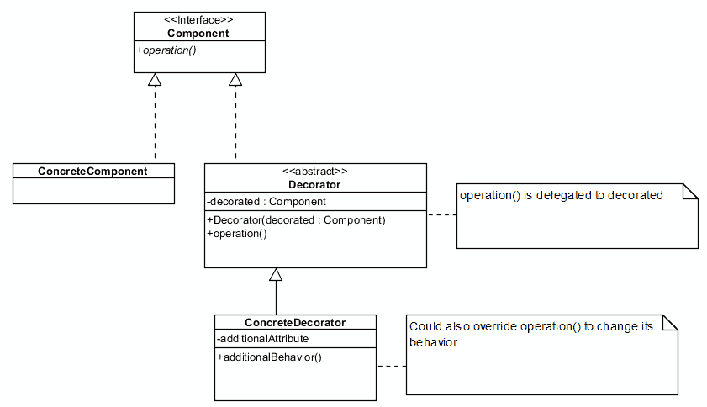
A Model of the Decorator Pattern

Slide 46
Abstract Classes
An abstract class is a class that is declared abstract
it may or may not include abstract methods
An abstract method is a method that is declared without an implementation (without braces, and followed by a semicolon), like this:
abstract void moveTo(double deltaX, double deltaY);
If a class includes abstract methods, then the class itself must be declared abstract
When an abstract class is subclassed, the subclass usually provides implementations for all of the abstract methods in its parent class. However, if it does not, then the subclass must also be declared abstract.

Slide 47
Abstract classes vs. Interfaces
Use abstract classes if:
You want to share code among several closely related classes.
You expect that classes that extend your abstract class have many common methods or fields, or require access modifiers other than public (such as protected and private).
You want to declare non-static or non-final fields. This enables you to define methods that can access and modify the state of the object to which they belong.
An example of an abstract class in the JDK is AbstractMap, which is part of the Collections Framework. Its subclasses (which include HashMap, TreeMap, and ConcurrentHashMap) share many methods (including get, put, isEmpty, containsKey, and containsValue) that AbstractMap defines.

Slide 48
Abstract classes vs. Interfaces
Use interfaces if:
You expect that unrelated classes would implement your interface. For example, the interfaces Comparable and Cloneable are implemented by many unrelated classes.
You want to specify the behavior of a particular data type, but not concerned about who implements its behavior.
You want to take advantage of multiple inheritance of type.
An example of a class in the JDK that implements several interfaces is HashMap, which implements the interfaces Serializable, Cloneable, and Map<K, V>. An instance of HashMap can be cloned, is serializable (which means that it can be converted into a byte stream; see the section Serializable Objects), and has the functionality of a map.

Slide 49
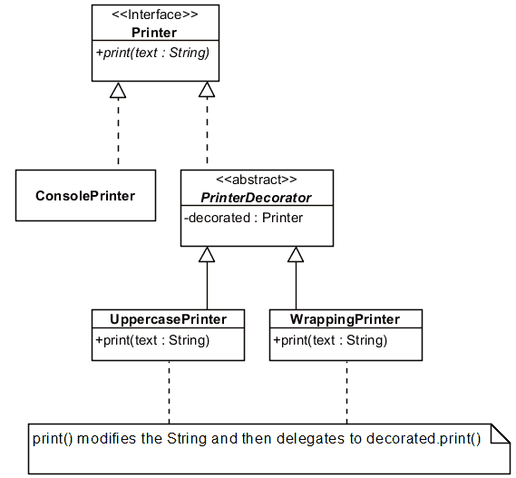
An Example

Slide 50
An Example (cont.)
Implementation

Slide 51
An Alternative Implementation
The Issue:
You need to decorate a class that does not implement an explicit interface
The Resolution:
Specialize the class to be decorated but still use delegation

Slide 52
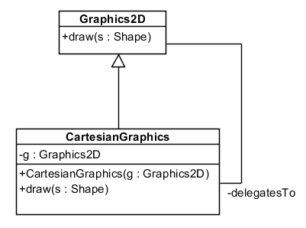
An Alternative Implementation (cont.)
An Example

Slide 53
Strategy

Slide 54
Overview
The "Problem":
Have a family of interchangeable algorithms for accomplishing the same objective
Examples:
Different text formatting algorithms (e.g., for paragraph formatting in a word processor)
Different metrics for finding the distance between, for example, colors

Slide 55
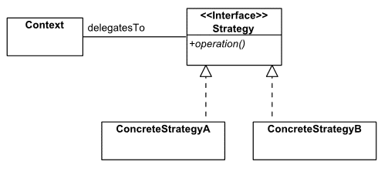
A Model of the Strategy Pattern
In UML

Slide 56
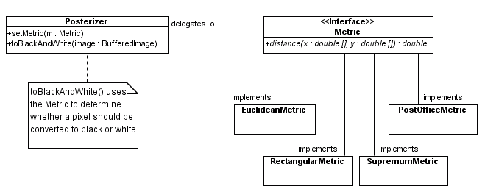
An Example of the Strategy Pattern
In UML

Slide 57
An Example (cont.)
Implementation

Slide 58
Factory Method

Slide 59
Overview
The "Problem":
A framework needs to standardize the architectural model for a range of applications, but allow for individual applications to define their own domain objects and provide for their instantiation.

Slide 60
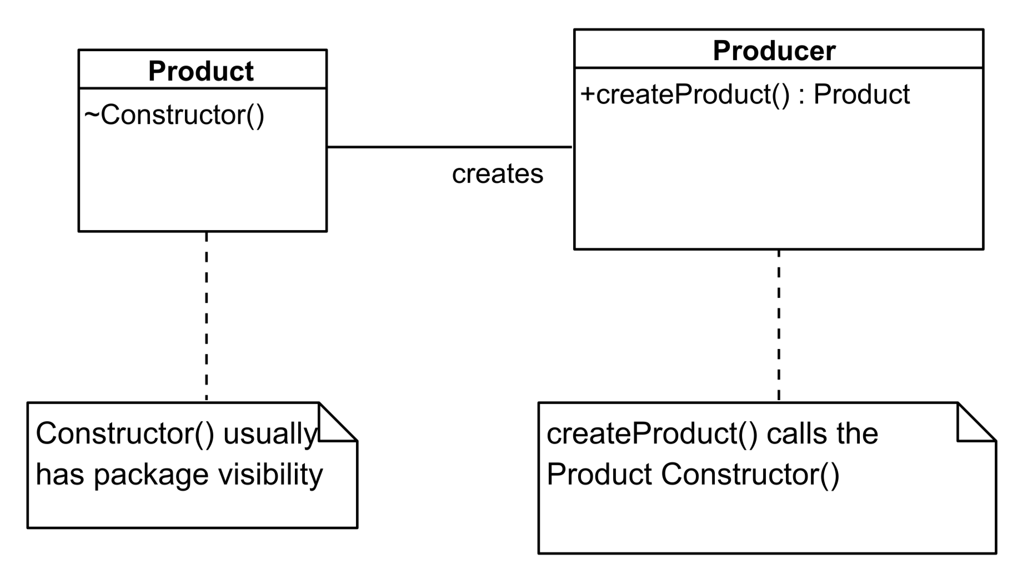
A Model

Slide 61
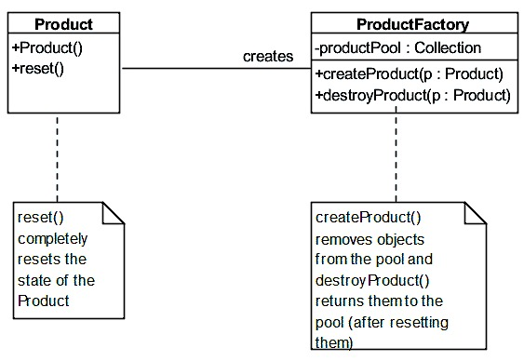
A Generic Example

Slide 62
A Specific Example
DirectoryListing

Slide 63
To Recap
Problems that factory method pattern can solve:
How can an object be created so that subclasses can redefine which class to instantiate?
How can a class defer instantiation to subclasses?
Solution:
Define a separate operation (factory method) for creating an object.
Create an object by calling a factory method.

Slide 64
A Complete Example (cont.)
Implementing the Good Design

